Slide 1
Azure Machine Learning
Microsoft Research

Slide 2
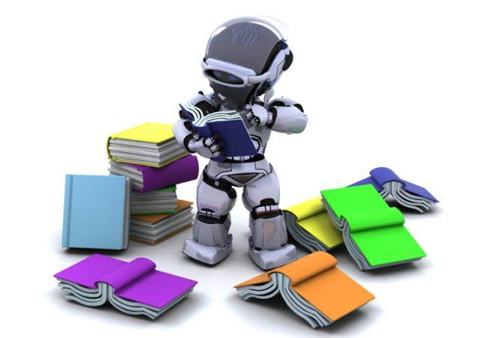
What is Machine Learning?
Computer "learns" from data in order to perform predictive analytics
Credit-card fraud detection
Online shopping recommendations
Self-driving cars and more
Supervised learning
Unsupervised learning
Notes:
Machine Learning finds patterns in large volumes of data and uses those patterns to perform predictive analysis. Microsoft offers Azure Machine Learning, while Amazon offers Amazon Machine Learning and Google offers the Google Prediction API. Software products such as MATLAB support traditional, non-cloud-based ML modeling.
Machine learning models fall into two broad categories: supervised and unsupervised. In supervised learning, the model is "trained" with a large volume of data and algorithms are then used to predict an outcome from future inputs. Most supervised learning models use regression algorithms to compute an outcome from a continuous set of possible outcomes (for example, your score on a test), or classification algorithms to compute the probability of an outcome from a finite set of possible outcomes (for example, the probability that an e-mail is spam or a credit-card transaction is fraudulent). In unsupervised learning, the computer isn't trained, but is presented with a set of data and challenged to find relationships in it. K-Means Clustering is a common unsupervised learning algorithm. For a great explanation of how it works, see https://blog.intercom.io/machine-learning-way-easier-than-it-looks/.

Slide 3
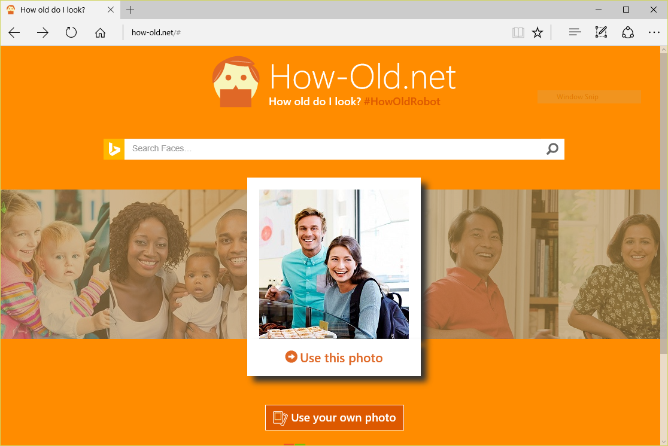
Machine Learning in Action
Notes:
https://how-old.net/# offers a great example of machine learning in action. Created by Microsoft, the site uses advanced image-recognition techniques to analyze photos you upload and then uses an ML model to "predict" the ages of the people in the photos.

Slide 4
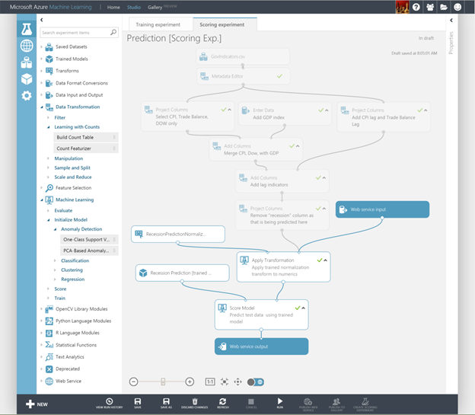
Azure Machine Learning
Cloud service for building sophisticated ML models
Includes ML Studio for composing experiments
Classification, regression, anomaly detection, and more
Supports text input, CSV, TSV, OData, RData, ZIP, and more
Supports R and Python
Embodies years of research
Notes:
Machine Learning finds patterns in large volumes of data and uses those patterns to perform predictive analysis. Microsoft offers Azure Machine Learning, while Amazon offers Amazon Machine learning and Google offers the Google Prediction API. Software products such as MATLAB support traditional, non-cloud-based ML modeling. To show a great example of ML at work, demo https://how-old.net/#.

Slide 5


I spent last semester building a regression model in Python, and I just did the same thing in 10 minutes with Azure ML
Notes:
This quote came from a graduate student who attended this class at UMass. He had already accepted at offer to go to work for Microsoft post-graduation. ☺

Slide 6
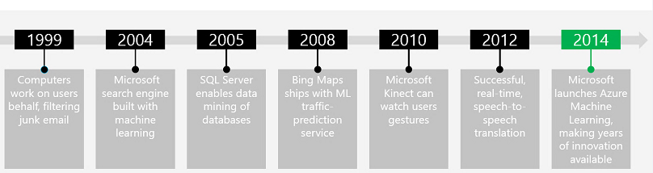


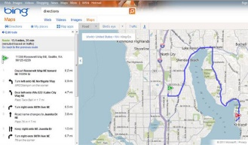
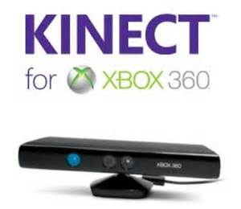
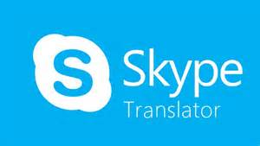


Microsoft Machine Learning History
Modified from http://pulsweb.fr/predict-wine-quality-azureml

Slide 7
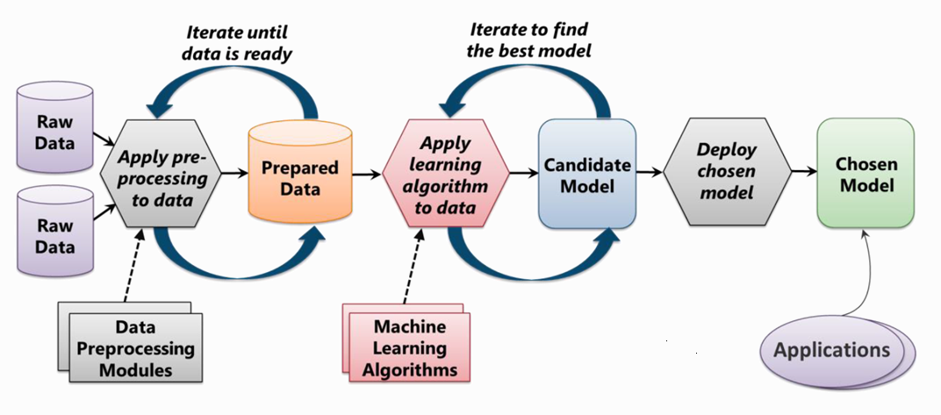
Machine Learning Process
From: Introduction to Microsoft Azure by David Chappell

Slide 8
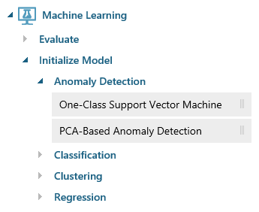
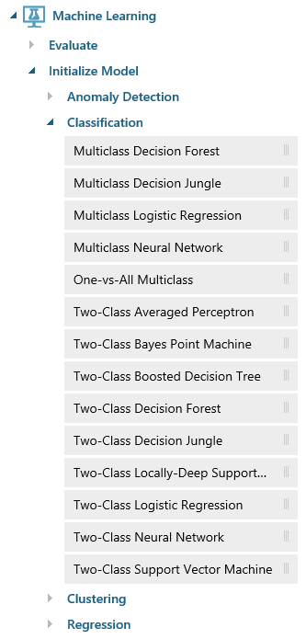
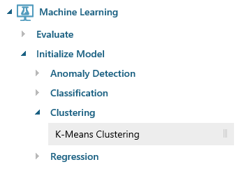
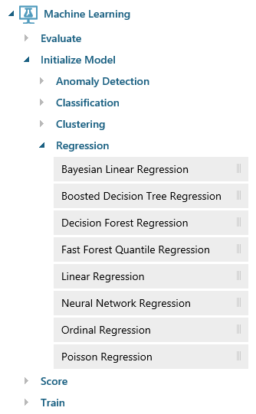
Azure ML Algorithms
Notes:
Anomaly detection is the identification of items, events, or observations which do not conform to an expected pattern or other items in a dataset. A classic example is examining a dataset representing banking transactions and detecting potentially fraudulent transactions in that group.
Regression algorithms seek to establish and quantify relationships between variables. By establishing a relationship between a dependent variable and one or more independent variables, regression analysis can enable the value of a dependent variable to be predicted given a set of inputs with a quantifiable accuracy. A great example can be seen at https://how-old.net/#, a site that lets you upload a photo and then guesses your age with uncanny accuracy. The site uses Azure Machine Learning and combines classic regression with advanced image recognition.
The purpose of classification algorithms is to identify the category to which an observation belongs based on training data consisting of observations which have already been classified (assigned to a category). A great example is determining whether an e-mail belongs to the "spam" category or the "not-spam" category.
Clustering seeks to group a set of objects in such a way that objects in the same group (called a cluster) are more similar to each other than to those in other groups (clusters).

Slide 9
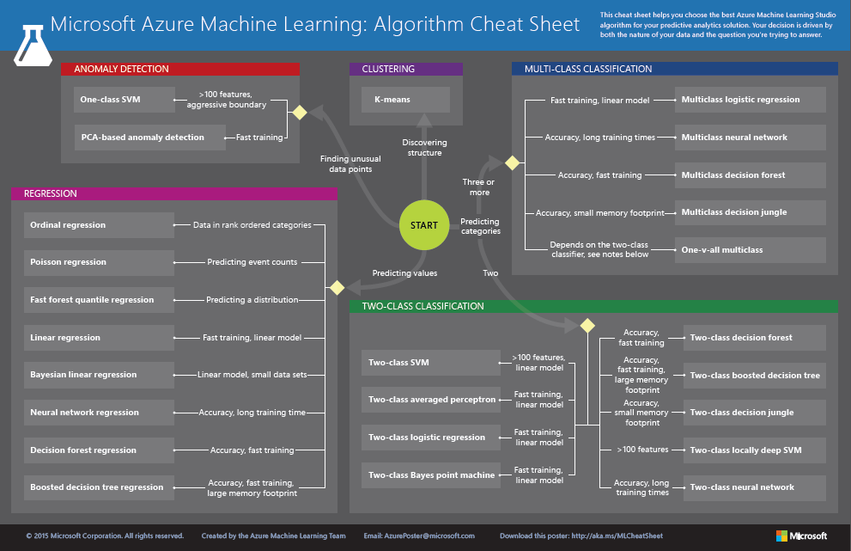
http://aka.ms/MLCheatSheet
Notes:
One example here is if you want to use a set of input values to predict an output value, use linear regression. But if you're more interested in the distribution of the output use fast forest quantile regression instead. An example of when you would use the latter is using growth charts to assess child development. "Abby's height is in the 10% quantile of the heights of kids her age."

Slide 10
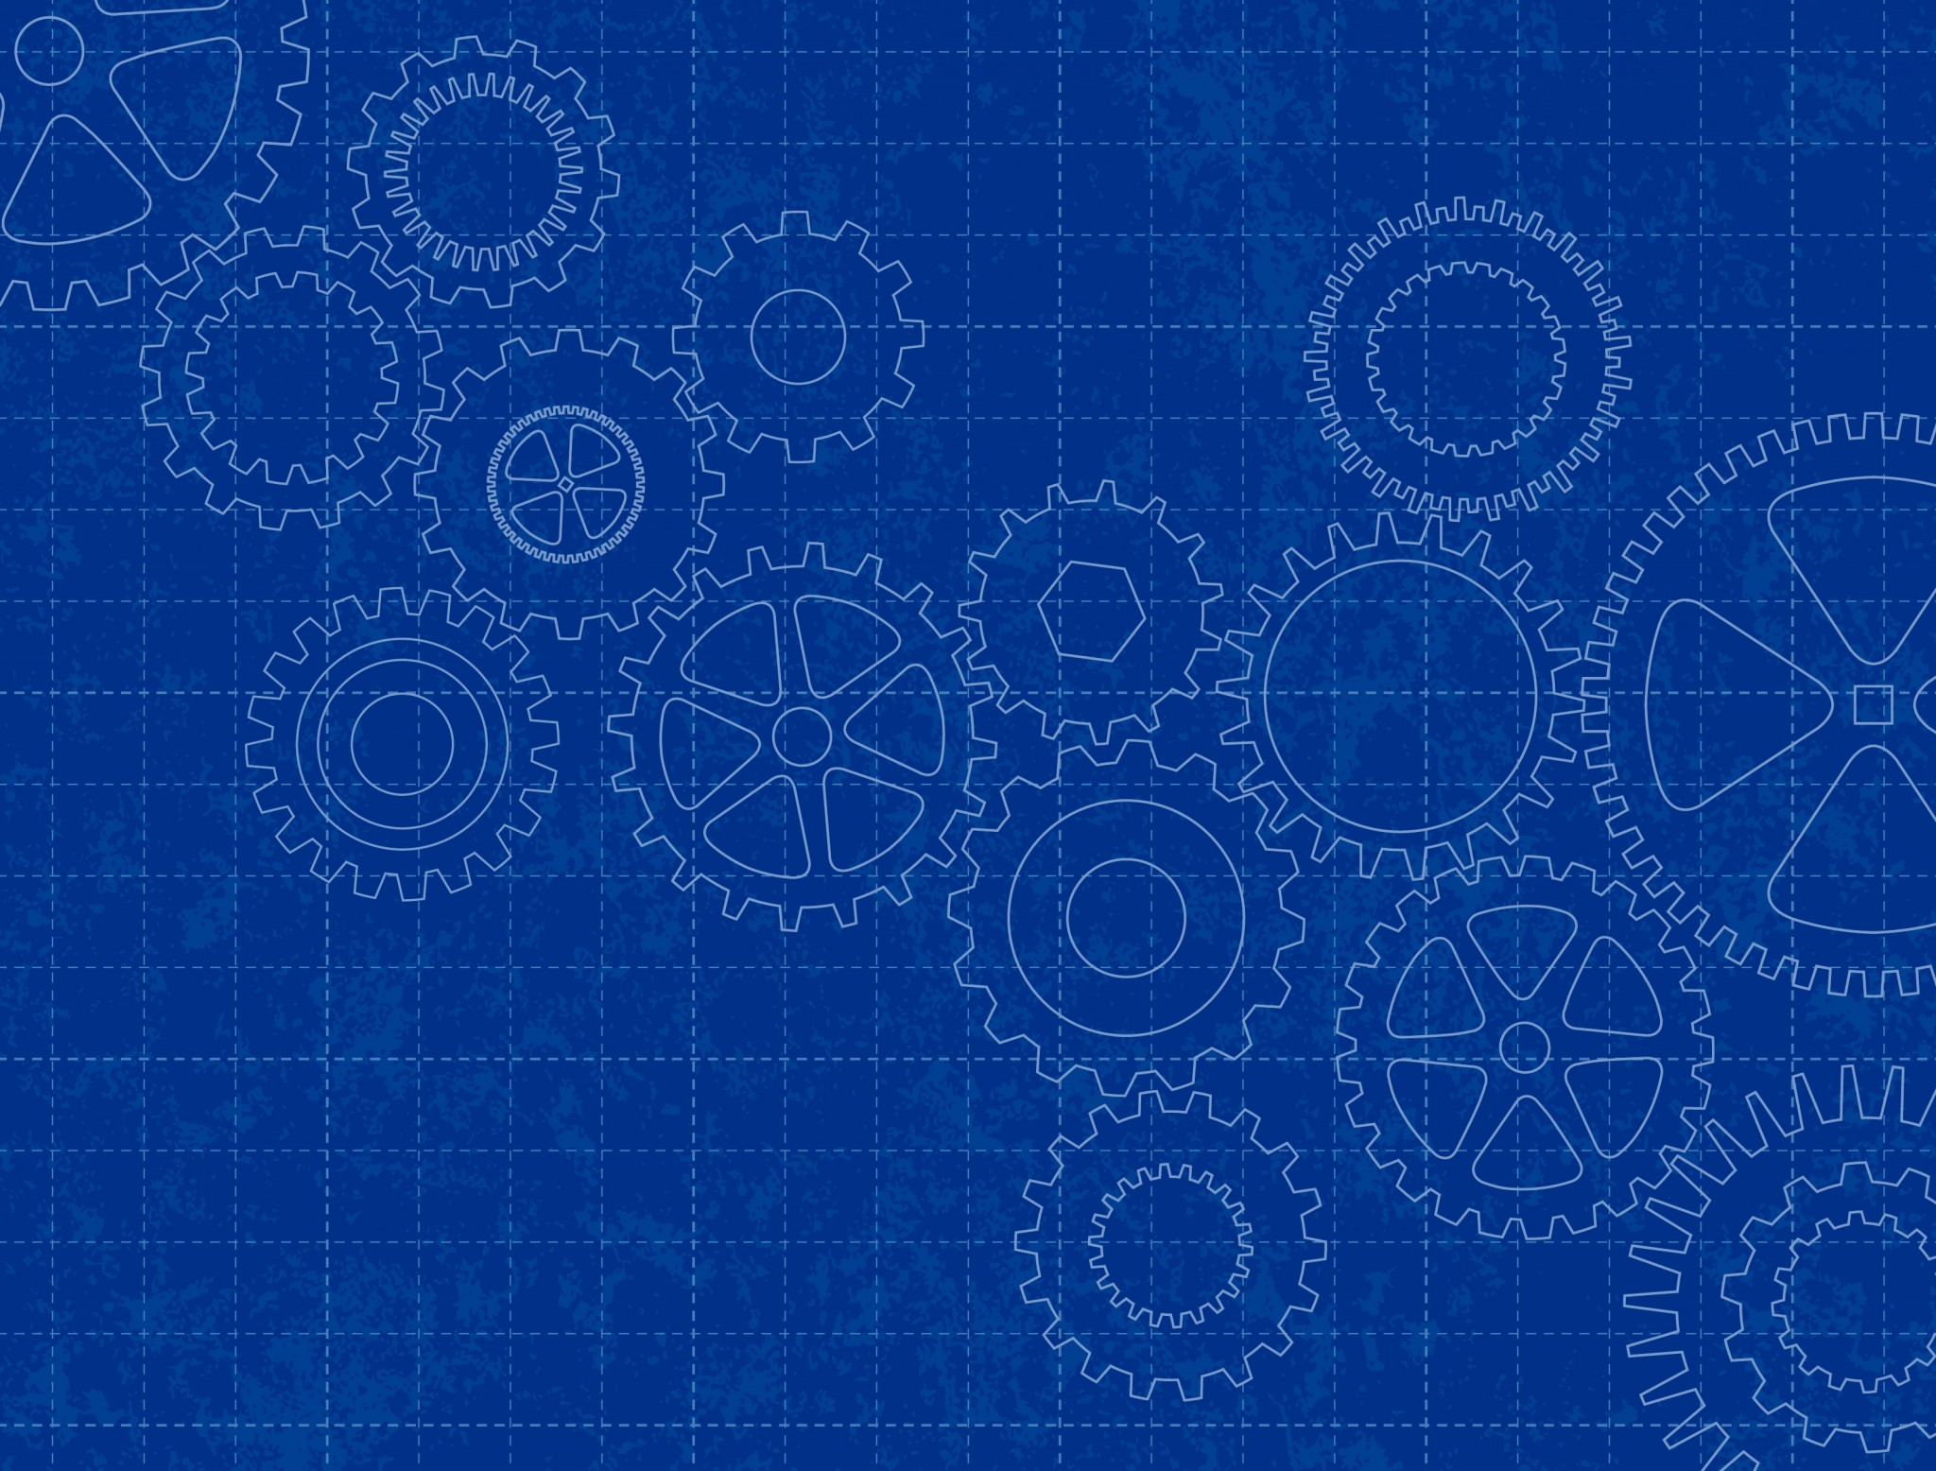
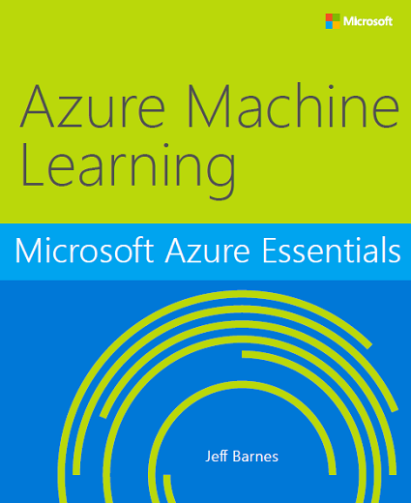
Free e-Book
http://bit.ly/a4r-mlbook

Slide 11
Hands-On Lab
Using Azure Machine Learning
Azure Machine Learning HOL.html

